Slide 1
Hand gesture control
Tools: Python | OpenCV | Mediapipe | PyAutoGUI | PyCaw
Team Size: 4 Members
Group no. - 04

Slide 2
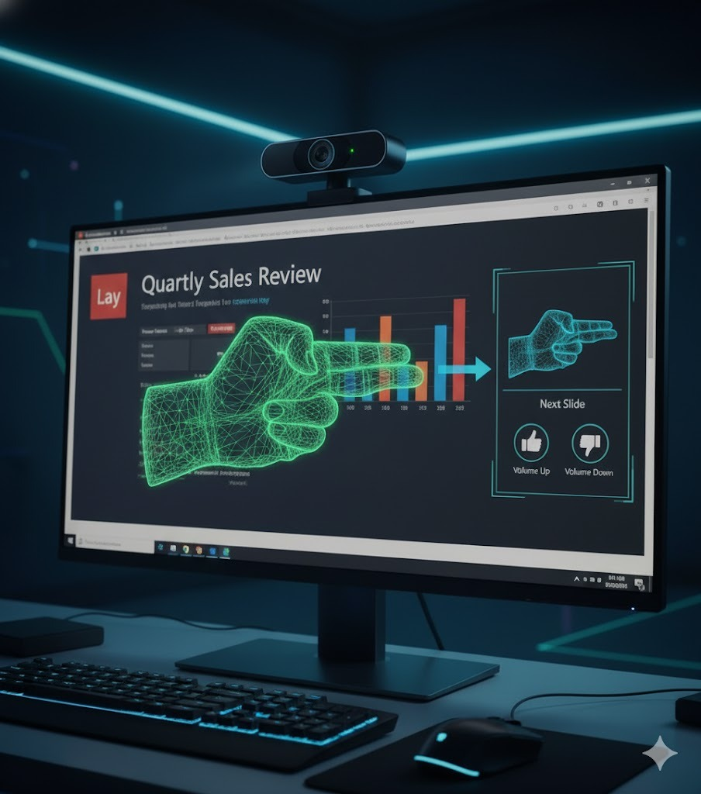
INTRODUCTION
Enables touch-free control of presentations
Uses hand gestures instead of keyboard or mouse
Detects finger positions via webcam
Ensures a smooth and uninterrupted presentation flow

Slide 3
PROBLEM STATEMENT
Frequent use of keyboard/mouse distracts presenters and breaks their connection with the audience during presentations.
Touch control is inconvenient in lectures or seminars, requiring constant movement near the system.
There is a need for a contactless, hygienic, and intuitive control method to ensure smooth, hands-free presentation flow.

Slide 4
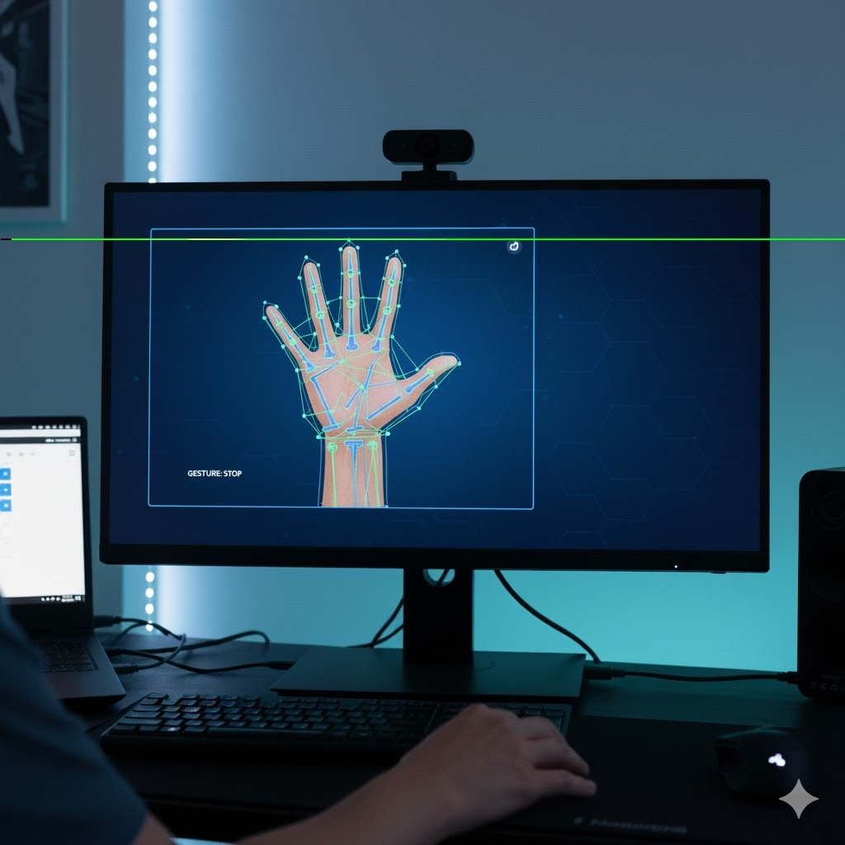
PROPOSED SOLUTION
Real-time hand tracking using Mediapipe: Detects and tracks hand movements through webcam feed for smooth gesture input.
Gesture recognition for slide and volume control: Recognizes specific gestures to navigate slides and adjust system volume.
Command execution using PyAutoGUI & PyCaw: Automates slide transitions and volume control through system-level commands.
Simple GUI feedback: Displays real-time visual cues confirming recognized gestures and actions performed.

Slide 5
SYSTEM WORKFLOW
Flow -
Webcam → Hand Tracking → Gesture Recognition → System Action
Overview -
The webcam captures live video, Mediapipe tracks hand movements, and recognized gestures trigger specific actions like slide change or volume control using PyAutoGUI and PyCaw. A Tkinter-based GUI provides instant visual feedback.
Modules -
OpenCV - Video input
Mediapipe - Gesture detection
PyAutoGUI - Slide control
PyCaw - Volume control
Tkinter - GUI feedback

Slide 6
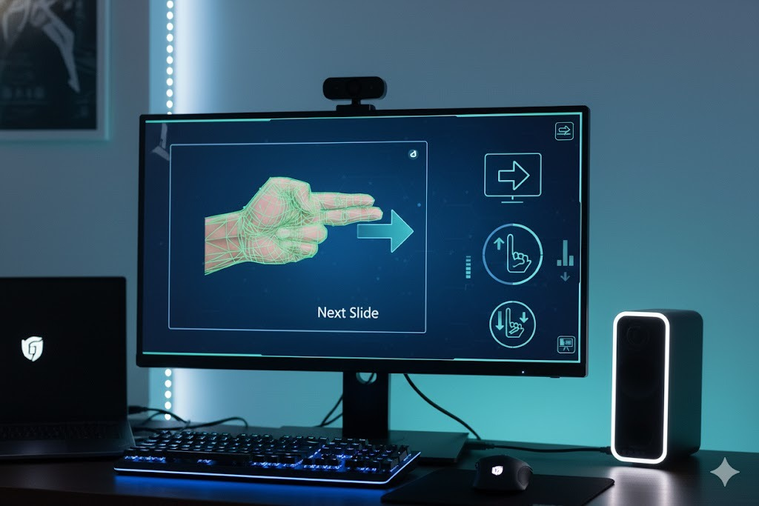
EXPECTED OUTPUT
Gesture-based slide control: Move to next or previous slides easily.
Volume adjustment: Control system volume through hand gestures.
Real-time feedback: On-screen indicators show detected actions.
Touch-free experience: Ensures smooth, hygienic, and modern presentations.

